Slide 1

EfficientSINet-B4: Enhancing Crowd Counting with EfficientNet and Shunting Inhibition Mechanism

Slide 2
Department of Computer Science and Engineering
EfficientSINet-B4: Enhancing Crowd Counting with EfficientNet and Shunting Inhibition Mechanism
PRESENTED BY
Yerragunta Mahesh Kumar Reddy 22471A0570
Lathika Charan Mani 22471A0555
Chepuri Chaitanya Venkat 22471A0508
Vinukonda Joshi 22471A0565
Under the Guidance of,
M.Sathyam Reddy _{M.Tech,}
Assistant Professor,
Department of Computer Science and Engineering,
Narasaraopeta Engineering College (Autonomous),
Narasaraopet- 522 601.

Slide 3
OUTLINE
Abstract
Introduction
Literature Survey
Research Gaps
Problem Statement
Objectives
Block Diagram / Flow Diagram
Methodology
Implementation
Results and Analysis
Conclusion & Future Scope
References
Question and Answers
Acknowledgements

Slide 4
ABSTRACT
Crowd counting from images is crucial for security, crowd management, and smart surveillance. The Shunting Inhibition Network (SINet) uses biologically inspired segmentation but struggles in dense scenes due to its shallow encoder. To enhance performance, the encoder is replaced with EfficientNet-B4, a deeper and more powerful network. This improved model extracts richer features and achieves superior results on the ShanghaiTech Part-A dataset, with an MAE of 36.4 and RMSE of 85.4, outperforming the original SINet.

Slide 5
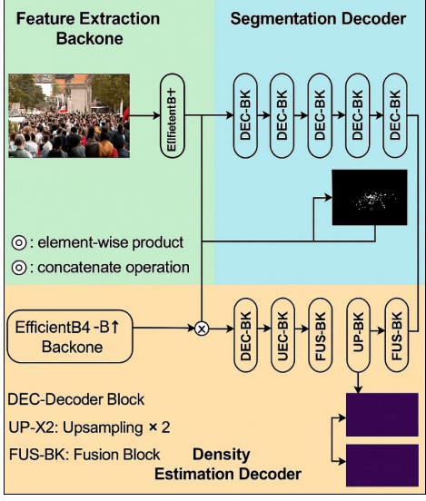
Efficient Crowd Counting Model
Dual-decoder deep learning model for crowd counting
Integrates segmentation and density estimation
Designed for highly crowded and complex scenes
EfficientNet-B4 / B1 used as backbone
Extracts multi-scale and high-level features

Slide 6
INTRODUCTION
Crowd counting plays an important role in maintaining public safety, managing large gatherings, and improving smart surveillance systems.
It helps estimate the number of people in an image or video, even in dense and complex crowd environments.
Traditional counting methods struggle with challenges such as occlusion, scale variation, and background clutter.
Deep learning models like the Shunting Inhibition Network (SINet) use biologically inspired mechanisms for better crowd analysis.
To enhance performance, the proposed model combines EfficientNet-B4 with SINet, allowing deeper feature extraction and improved accuracy.
Our project fits with the trend of using advanced deep learning technology to make crowd monitoring and public safety smarter and more efficient.

Slide 7
LITERATURE SURVEY
No | Title | Author | Journal Name & Year | Methodology Adapted | Key Findings | Gaps
1 | U-ASD Net: Supervised Crowd Counting Based on Semantic Segmentation & Adaptive Scenario Discovery | Adel Hafeezallah et al. | Science Direct (2023) https://doi.org/10.1016/j.measea.2023.100773 | Resizing to 576×768- Density/attention maps via Gaussian filters- Max-unpooling replaces upsampling- Point annotations converted for training | Achieves better performance via multi-branch learning- Introduces max-unpooling to recover spatial info- Uses semantic segmentation + adaptive recalibration- Proposes new Haramain dataset | Higher inference cost due to dual-path computation_x0002_Haramain dataset lacks public access currently
2 | NWPU-Crowd: A Large_x0002_Scale Benchmark for Crowd Counting and Localization | Qi Wang et al., | IEEE (2021) https://doi.org/10.1109/INMIC50486.2020.9318052 | Resizing to 2048px with aspect ratio_x0002_Random crop (576×768)- Grayscale conversion, gamma correction_x0002_Gaussian density map (kernel=15) | Introduces largest real-world crowd dataset (2.13M heads, 5,109 images)- Includes box-level + point-wise annotations- Negative samples for robustness testing_x0002_Benchmark platform enables fair evaluation | High-resolution training costly_x0002_Difficulties in dense head detection- Model performance varies across luminance and density classes
3 | Redesigning Multi-Scale Neural Network for Crowd Counting | Zhipeng Du et al., | Journal of Musculoskeletal Surgery and Research (2021) http://dx.doi.org/10.4103/jmsr.jmsr_132_20 | HMoDE (Hierarchical Mixture of Density Experts)• Two-level MoE fusion• Pixel_x0002_wise soft gating• Relative Local Counting Loss | Redefines multi-scale fusion using per-pixel expert weighting- Joint optimization of density map + local count improves robustness- Outperforms SOTA on five benchmarks | - Gating net tuning can be complex- Local region hard_x0002_mining thresholds are dataset_x0002_dependent
4 | Scale-Aware Crowd Counting Network With Annotation Error Modeling | Yi-Kuan Hsieh et al., | IEEE (2017) https://doi.org/10.1109/ICIIECS.2017.8275843 | SACC-Net (VGG-19 + new fusion modules)• SFM (Synthetic Fusion Module)• IFM (Intra-Block Fusion Module)• CAN + ASPP• New Scale-Aware Loss Function | - First to jointly handle annotation error + scale variations- Introduces dynamic Gaussian-based loss for realistic human sizes- Lightweight variant (SACC-LW) enables real-time performance | Assumes isotropic annotation error- Gaussian approximation needs large memory unless reduced- Requires high annotation density

Slide 8
Literature Survey
Key Findings from Existing Research:
CNN-based deep learning models are widely used for crowd counting and density estimation
Multi-scale architectures improve performance in highly dense and occluded scenes
Segmentation-guided approaches enhance spatial localization of crowd regions
Gaussian-based density map generation is commonly adopted using point annotations
Large-scale datasets (e.g., NWPU-Crowd, ShanghaiTech) enable robust model evaluation
Recent works focus on improving accuracy through feature fusion and expert-based models
Limitations Identified:
Difficulty in handling extremely dense crowds with severe occlusions
Over-estimation of crowd count in highly congested regions
High computational and inference cost in complex architectures
Limited generalization across real-world and unseen scenarios
Insufficient integration of segmentation and density estimation in many models
Dependence on dataset-specific tuning and fixed Gaussian kernels

Slide 9
RESEARCH GAPS
Existing crowd counting models struggle to handle extreme density variations and heavy occlusions in real-world images.
Most models lack efficient feature extraction mechanisms suitable for complex and high-resolution crowd scenes.
Traditional encoder–decoder networks often fail to balance model accuracy and computational efficiency.
Limited research explores biologically inspired mechanisms like shunting inhibition combined with modern deep encoders.

Slide 10
PROBLEM STATEMENT
In real-world scenarios, accurately estimating crowd density and count remains challenging due to variations in scale, perspective, and severe occlusions.
Existing models like SINet utilize biologically inspired mechanisms but rely on shallow encoders that limit feature extraction in dense and complex scenes.
Traditional CNN-based models struggle to balance accuracy and computational efficiency when applied to large-scale crowd images.
There is a need for an enhanced model that integrates a deeper and more efficient encoder to improve in high-density environments.
Therefore, this research aims to develop an improved SINet model using EfficientNet-B4 as the encoder to achieve better accuracy, scalability, and real-time applicability in crowd counting.

Slide 11
OBJECTIVES
To design a deep learning model capable of accurately estimating crowd density and count from complex real-world images.
To enhance the Shunting Inhibition Network (SINet) by integrating EfficientNet-B4 as a powerful and efficient encoder.
To improve feature extraction and representation for handling varying crowd densities, occlusions, and background clutter.
To develop a lightweight and computationally efficient model suitable for real-time crowd monitoring applications.
To evaluate the proposed model on benchmark datasets like ShanghaiTech Part-A and validate its performance against existing methods.

Slide 12
BLOCK DIAGRAM OR FLOW DIAGRAM
Input Crowd Image
Pre - Processing
Image Resizing
Feature Extraction (Encoder)
EfficientNet-B4 Backbone
Normalization
Shunting Inhibition Module
Enhances Key Features
Generates Density Map
Density Map Generation
Multi-scale Feature Extraction
Suppresses Background Noise
Classification Decoder Network
Crowd Output

Slide 13
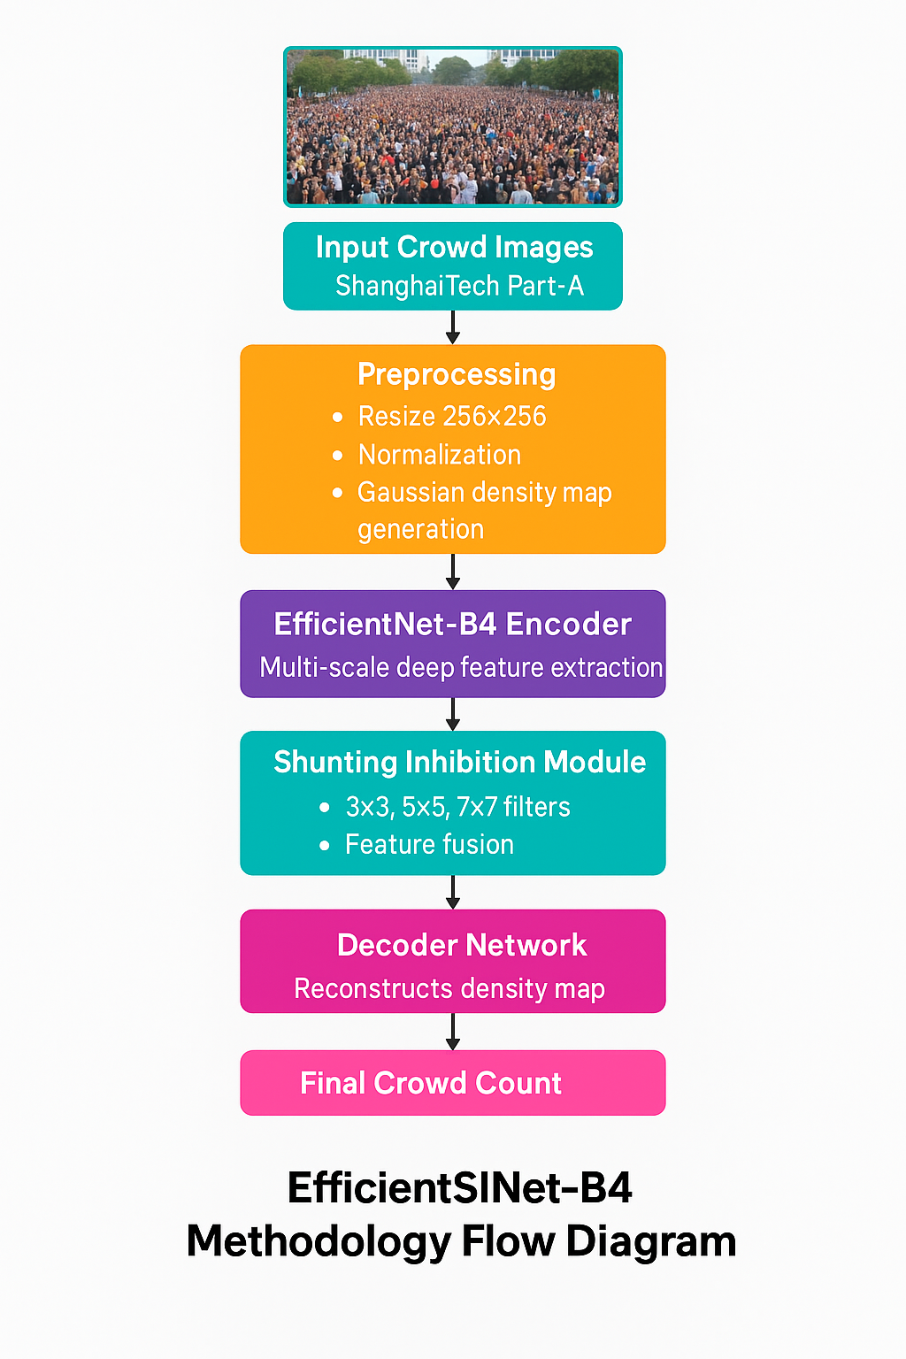
METHODOLOGY
Input crowd images are collected from the ShanghaiTech Part-A dataset.
Images are resized and normalized to ensure consistent input dimensions.
Ground truth density maps are generated from .mat files using Gaussian filters.
EfficientNet-B4 encoder extracts deep multi-scale features from the preprocessed images.
Shunting Inhibition module enhances crowd-related features and suppresses background noise.
Decoder network reconstructs the density map from extracted features.
Final crowd count is estimated by integrating the predicted density map values.

Slide 14
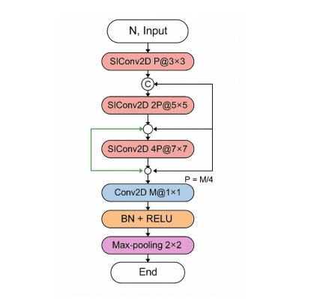
SINet Block – Working
Input image is given to the network
Multiple convolution layers are applied with different kernel sizes
3×3, 5×5, and 7×7 filters capture features at different scales
Features from all layers are combined together
1×1 convolution reduces feature size
Batch Normalization and ReLU improve learning
Max-pooling reduces spatial size
Output features are passed to the next stage

Slide 15
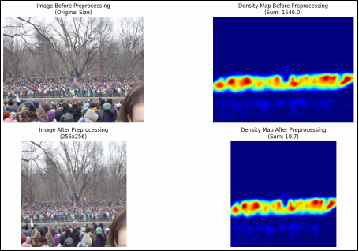
Before and After Preprocessing
Image & Density Map Preprocessing
The top images show the original input image and density map
The bottom images show the image and density map after preprocessing
Images are resized to a fixed size for model input
Density maps are resized to match the image size
Preprocessing removes noise and improves clarity
Crowd regions become more clear after preprocessing
This helps the model learn better and give accurate results

Slide 16
IMPLEMENTATION
Hardware Specifications:
Processor : Intel Core i7Gen or above
RAM : 8GB (4 GB usable)
System Type : 64-bit operating system
Software Specifications:
Operating System : Windows 11 or above
Coding Language : Python
Python Distribution: Google COLAB

Slide 17
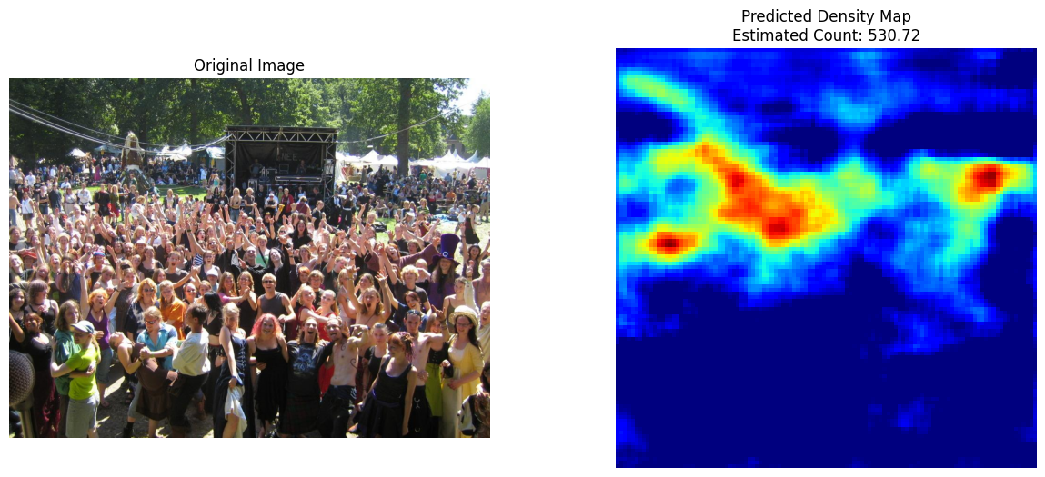
RESULTS & ANALYSIS
A. Pre-Processing

Slide 18
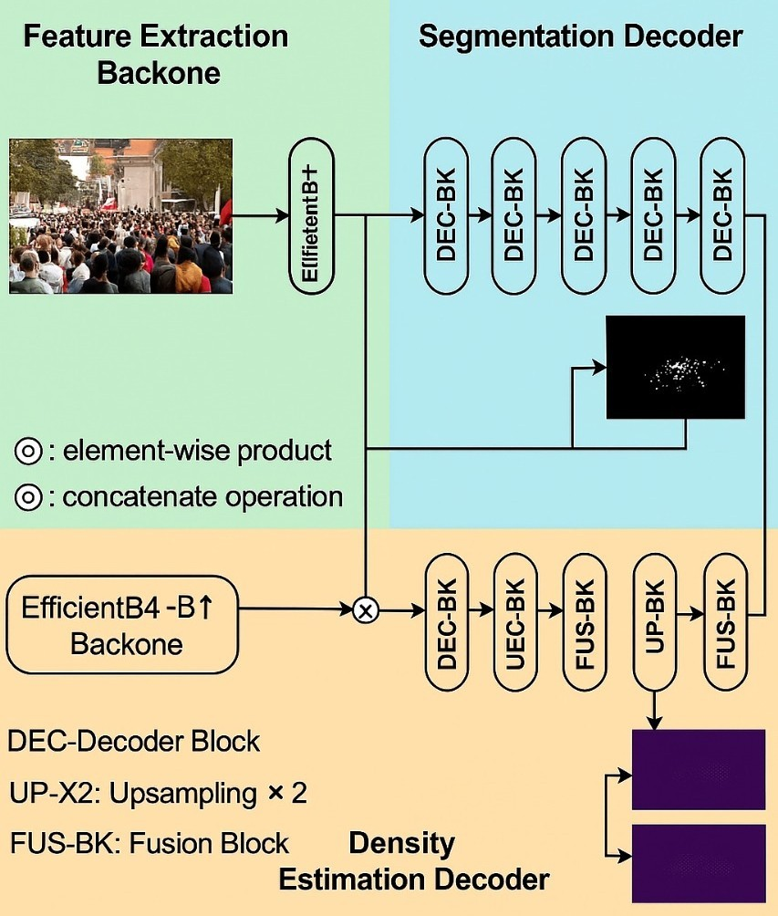
B. Feature Extraction
Feature Extraction
EfficientNet is used to extract features from crowd images
Input images are resized to a fixed size
Early layers learn basic patterns like edges
Deep layers learn dense crowd features
Helps improve crowd counting accuracy

Slide 19
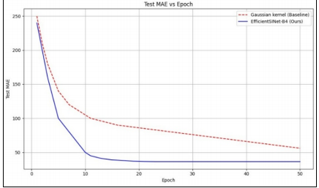
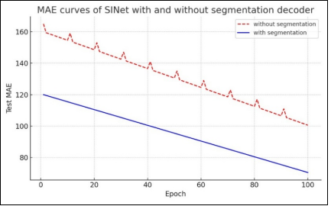
Performance Comparison (MAE vs Epoch)
MAE decreases as training epochs increase
Model with segmentation decoder gives lower MAE
Segmentation helps the model focus on crowd regions
Proposed model converges faster than baseline
Gaussian kernel method shows higher MAE
EfficientSINet-B4 achieves much lower MAE
Proposed model is more stable during training
Results show better accuracy and faster.

Slide 20
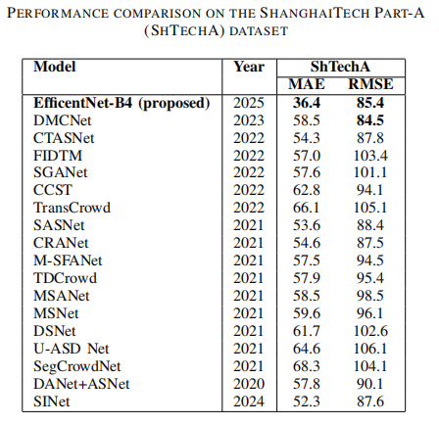
Performance Comparison (ShanghaiTech Part-A)
Comparison is done using MAE and RMSE metrics
Lower MAE and RMSE indicate better performance
EfficientNet-B4 (Proposed) achieves the best MAE (36.4)
Proposed model performs better than existing methods
Results show improved accuracy on dense crowd scenes

Slide 21
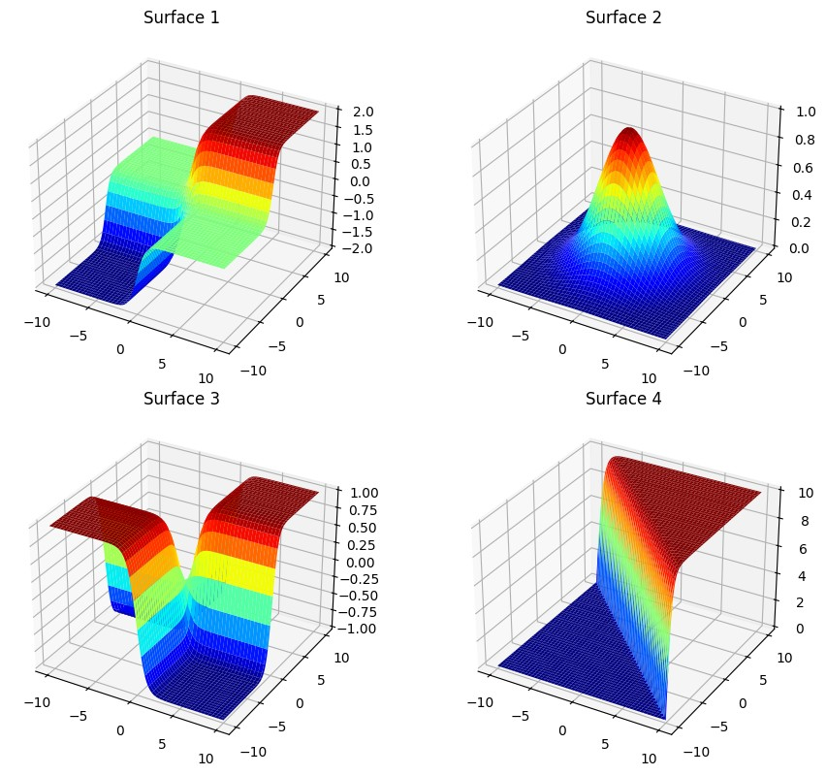
C. Surface Visualization

Slide 22
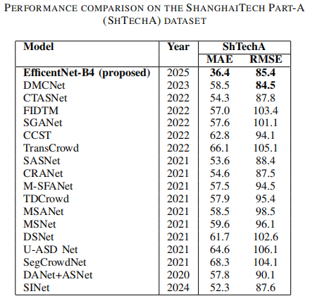
D. Classification

Slide 23
E.Coding
1. Imports
import os, cv2, numpy as np, tensorflow as tf
from scipy.io import loadmat, savemat
from tensorflow.keras import layers, models, callbacks
from google.colab import drive
from matplotlib import pyplot as plt
from scipy.ndimage import gaussian_filter
2. Mount Drive & Paths
drive.mount('/content/drive')
train_img_dir = "/content/drive/MyDrive/datasets/ShanghaiTech/part_A/train_data/images"
train_gt_dir = "/content/drive/MyDrive/datasets/ShanghaiTech/part_A/train_data/ground-truth"
test_img_path = "/content/drive/MyDrive/datasets/ShanghaiTech/part_A/train_data/images/IMG_101.jpg"

Slide 24
3. Density Map Function
def create_scaled_density_map(points, orig_shape, target_shape, sigma=4):
gt = len(points)
dm = np.zeros(orig_shape[:2], np.float32)
for p in points:
x,y = int(p[0]), int(p[1])
if 0<=x<orig_shape[1] and 0<=y<orig_shape[0]:
dm[y,x] = 1
dm = gaussian_filter(dm, sigma=sigma)
dm_resized = cv2.resize(dm, (target_shape[1], target_shape[0]))
if np.sum(dm_resized)>0:
dm_resized = (dm_resized / np.sum(dm_resized)) * gt
return dm_resized

Slide 25
4. Dataset Loader
def load_dataset(img_dir, gt_dir, max_images=250, target_shape=(112,112)):
X,Y = [], []
for file in sorted(os.listdir(img_dir))[:max_images]:
if file.endswith(".jpg"):
img = cv2.imread(os.path.join(img_dir,file))
img_resized = cv2.resize(img,(224,224)) / 255.0
mat = loadmat(os.path.join(gt_dir,f"GT_{file.replace('.jpg','.mat')}"))
points = mat["image_info"][0][0][0][0][0]
dmap = create_scaled_density_map(points, img.shape, target_shape)
X.append(img_resized); Y.append(np.expand_dims(dmap,-1))
return np.array(X), np.array(Y)
X_train, Y_train = load_dataset(train_img_dir, train_gt_dir)

Slide 26
5. Build Model
def build_crowd_model(input_shape=(224,224,3)):
inp = layers.Input(shape=input_shape)
x = layers.Conv2D(64,3,padding='same',activation='relu')(inp); x = layers.MaxPooling2D(2)(x)
x = layers.Conv2D(128,3,padding='same',activation='relu')(x); x = layers.MaxPooling2D(2)(x)
x = layers.Conv2D(256,3,padding='same',activation='relu')(x); x = layers.MaxPooling2D(2)(x)
x = layers.Conv2D(512,3,padding='same',activation='relu')(x)
x = layers.UpSampling2D(2)(x); x = layers.Conv2D(256,3,padding='same',activation='relu')(x)
x = layers.UpSampling2D(2)(x); x = layers.Conv2D(128,3,padding='same',activation='relu')(x)
out = layers.Conv2D(1,1,padding='same',activation='relu')(x)
return models.Model(inp,out)
model = build_crowd_model()
model.compile(optimizer=tf.keras.optimizers.Adam(1e-5), loss='mse')

Slide 27
6. Train Model
checkpoint = callbacks.ModelCheckpoint("best_model.keras", save_best_only=True)
model.fit(X_train, Y_train, epochs=50, batch_size=8, validation_split=0.1, callbacks=[checkpoint])

Slide 28
7. Predict & Visualize
def predict_and_save(img_path, threshold=40):
model = models.load_model("best_model.keras")
img = cv2.imread(img_path)
inp = cv2.resize(img,(224,224))/255.0
inp = np.expand_dims(inp,0)
density = model.predict(inp)[0,:,:,0]
count = np.sum(density)
if count < threshold: count = 0
savemat("predicted_density.mat", {"density_map": density})
plt.figure(figsize=(14,6))
plt.subplot(1,2,1); plt.imshow(cv2.cvtColor(img,cv2.COLOR_BGR2RGB)); plt.title("Original"); plt.axis('off')
plt.subplot(1,2,2); plt.imshow(density,cmap='jet'); plt.title(f"Count: {count:.2f}"); plt.axis('off')
plt.show()
predict_and_save(test_img_path)

Slide 29
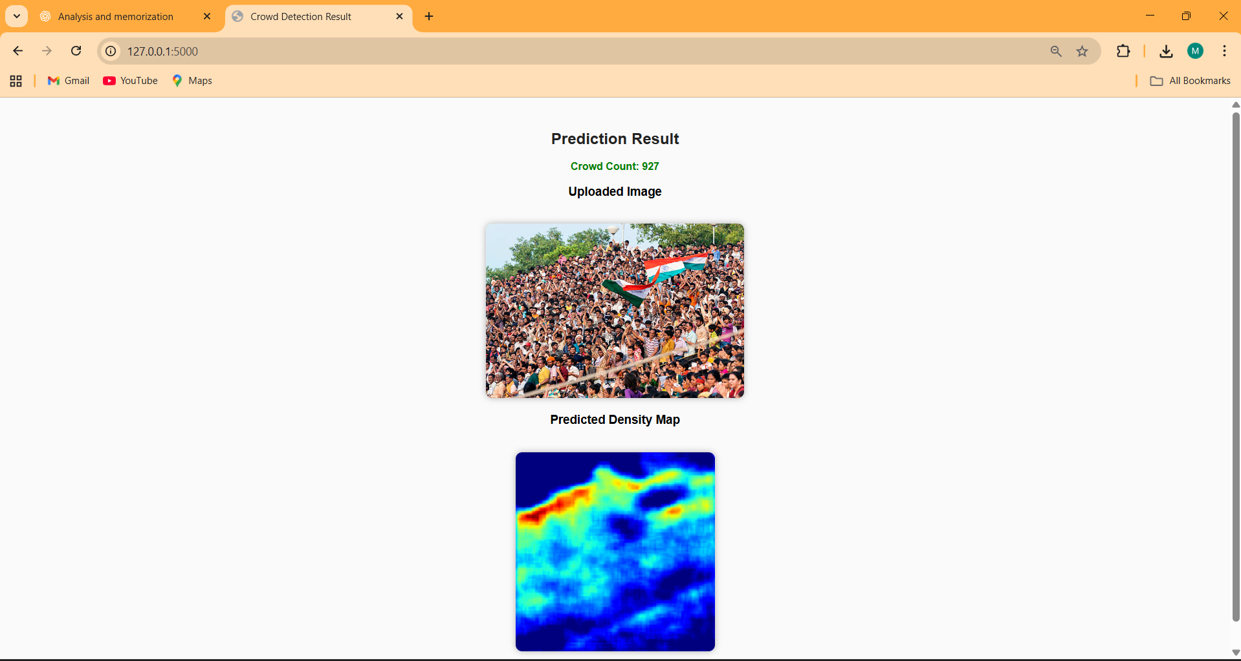
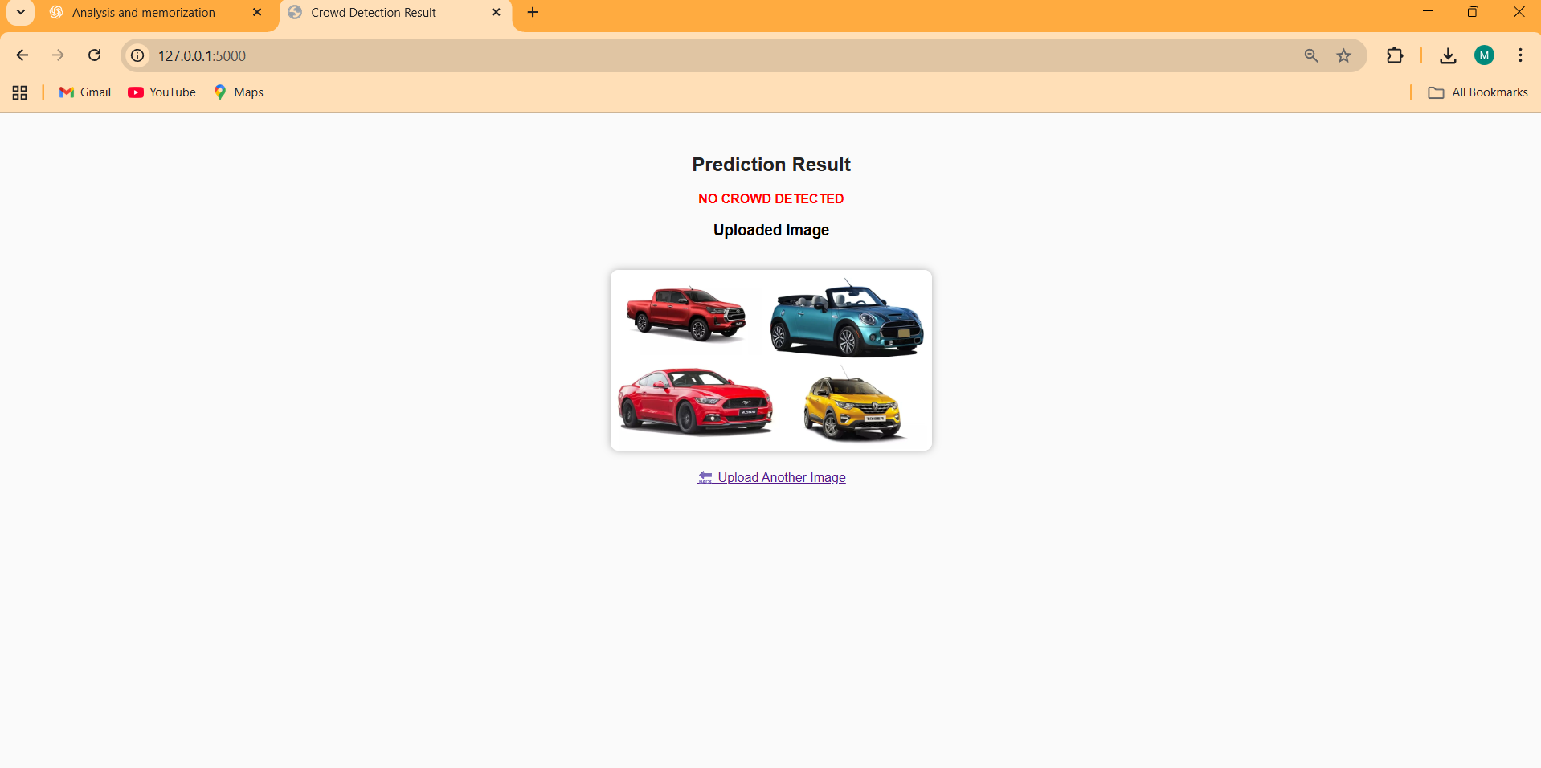
F. User Interface

Slide 30
CONCLUSION and FUTURE SCOPE
Developed an EfficientSINet-B4 model for accurate crowd counting on the ShanghaiTech Part_A dataset.
The proposed model significantly reduces MAE and RMSE, improving density map prediction accuracy.
Enhanced feature extraction using EfficientNet-B4 backbone improves crowd localization and count estimation.
Achieved a more efficient and lightweight network, suitable for real-time crowd monitoring applications.
Future work can explore cross-dataset generalization to handle diverse crowd scenarios.
Integrating temporal analysis for crowd flow prediction in video streams.

Slide 31
REFERENCES
Y. Zhang, D. Zhou, S. Chen, S. Gao, and Y. Ma, ”Single-Image CrowdCounting via Multi-Column Convolutional Neural Network,” in Proc.CVPR, 2016, pp. 589–597..
H. Idrees, I. Saleemi, C. Seibert, and M. Shah, ”Multi-source multi-scalecounting in extremely dense crowd images,” in Proc. CVPR, 2013, pp.2547–2554.
Y. Li, X. Zhang, and D. Chen, ”CSRNet: Dilated Convolutional NeuralNetworks for Understanding the Highly Congested Scenes,” in Proc.CVPR, 2018, pp. 1091–1100..
J. Wan et al., ”Residual Regression Network for Crowd Counting,” inProc. ICCV, 2019, pp. 1235–1244
T. Zhang et al., ”Radar-Transformer: Rethinking Crowd Counting withPrivacy-Preserving Sensor,” in Proc. ECCV, 2022.
X. Jiang et al., ”Attention Scaling for Crowd Counting,” in Proc. CVPR,2020.
J. He et al., ”CPSPNet: Crowd Counting via Semantic SegmentationFramework,” in Proc. ICTAI, 2020.

Slide 32

QUESTIONS and ANSWERS

Slide 33

ACKNOWLEGEMENTS

